Slide 1

Include and Optimize Diverse Talent

Slide 2

Objectives
Explain the basic definition of diversity.
Explain how differences among members benefit a group.
Illustrate the importance of inclusiveness to achieving purposeful diversity.
Develop simple, inclusive behaviors that can make diversity work for Scouting or another group.

Slide 3
Vision Statement
Scouting America will prepare every eligible youth in America to become a responsible, participating citizen and leader who is guided by the Scout Oath and Law.

Slide 4
None of us is as smart or as strong as all of us.

Slide 5
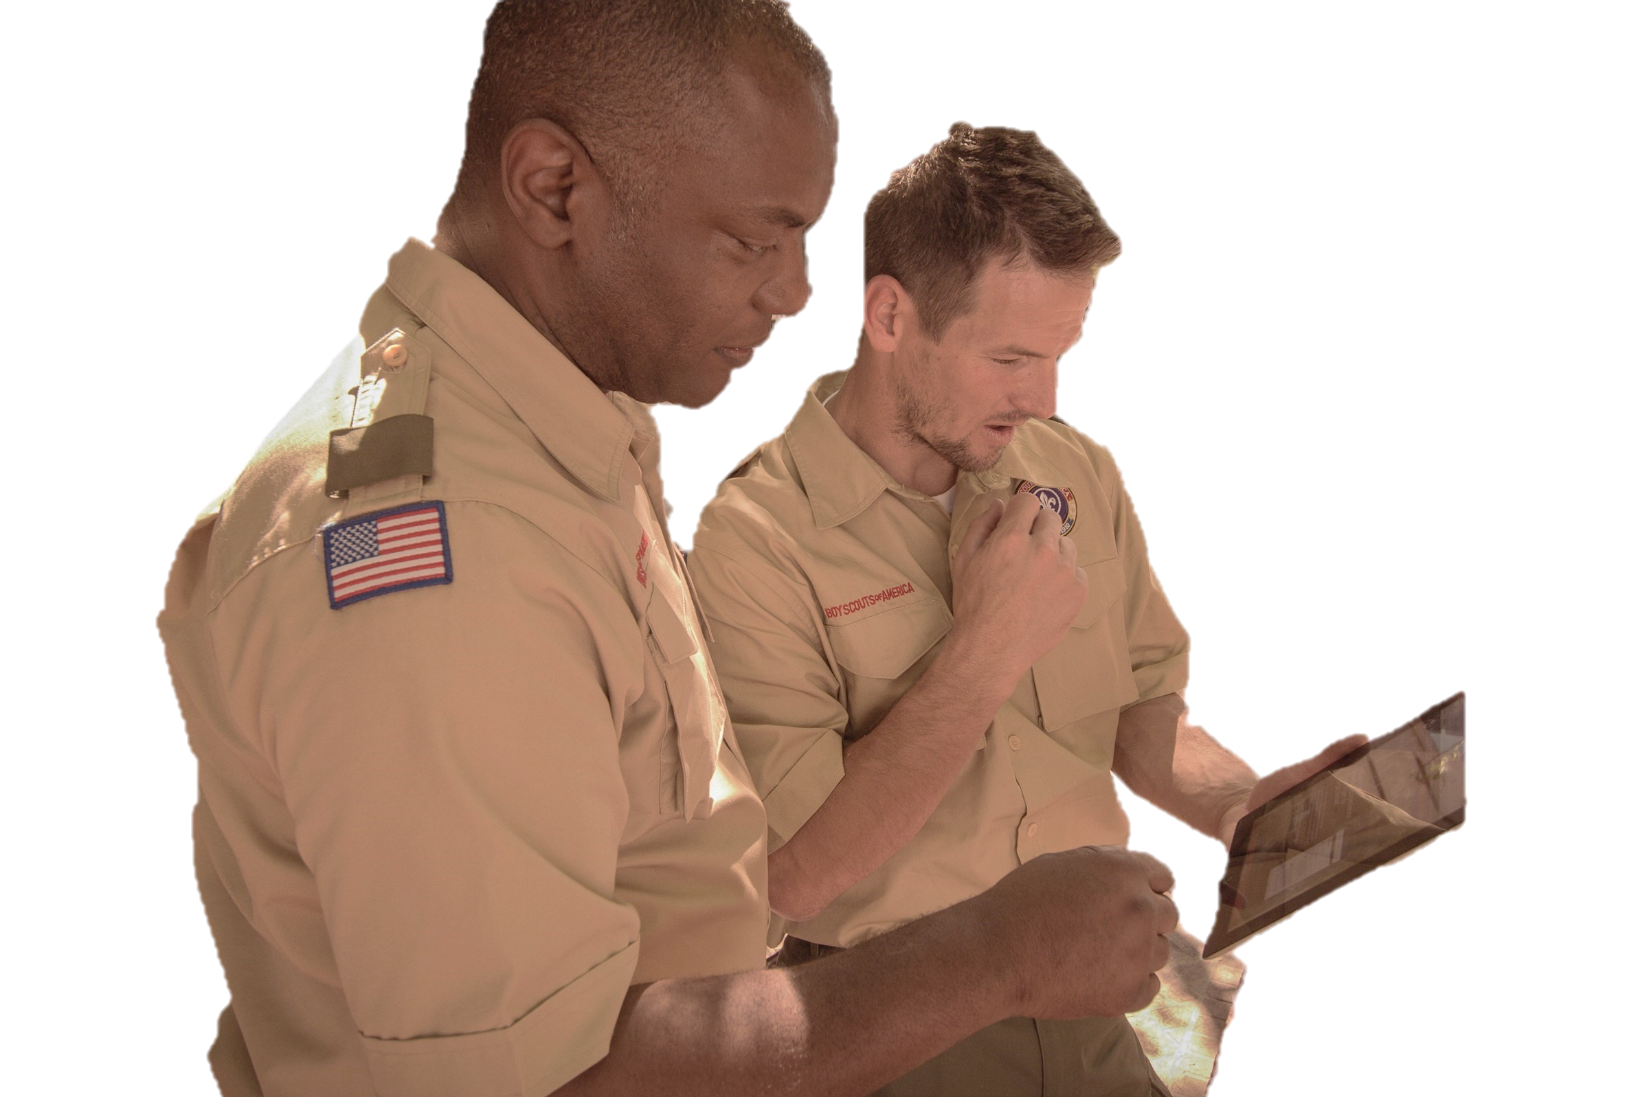
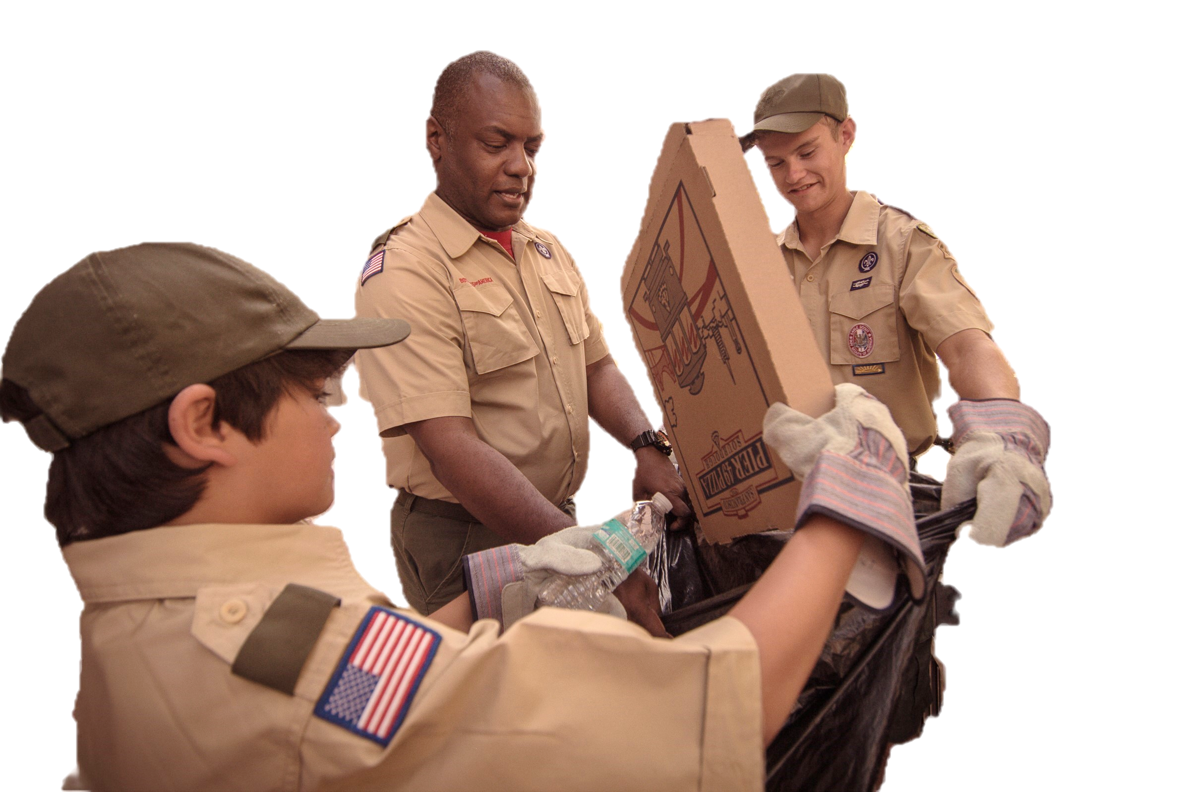
Who do you go to?

Slide 6

What is diversity?

Slide 7
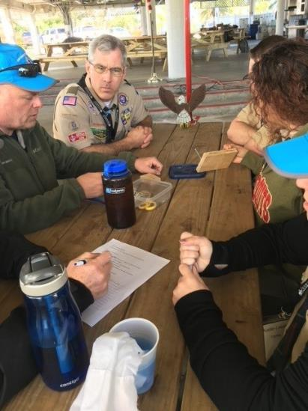
Pack Activity

Slide 8
Kinds of Diversity
Human

Slide 9
Kinds of Diversity
Cultural

Slide 10
Kinds of Diversity
Organizational

Slide 11

What can you know?

Slide 12
Values of

Slide 13
None of us is as smart or as strong as all of us.

Slide 14

Sometimes we fall short.

Slide 15
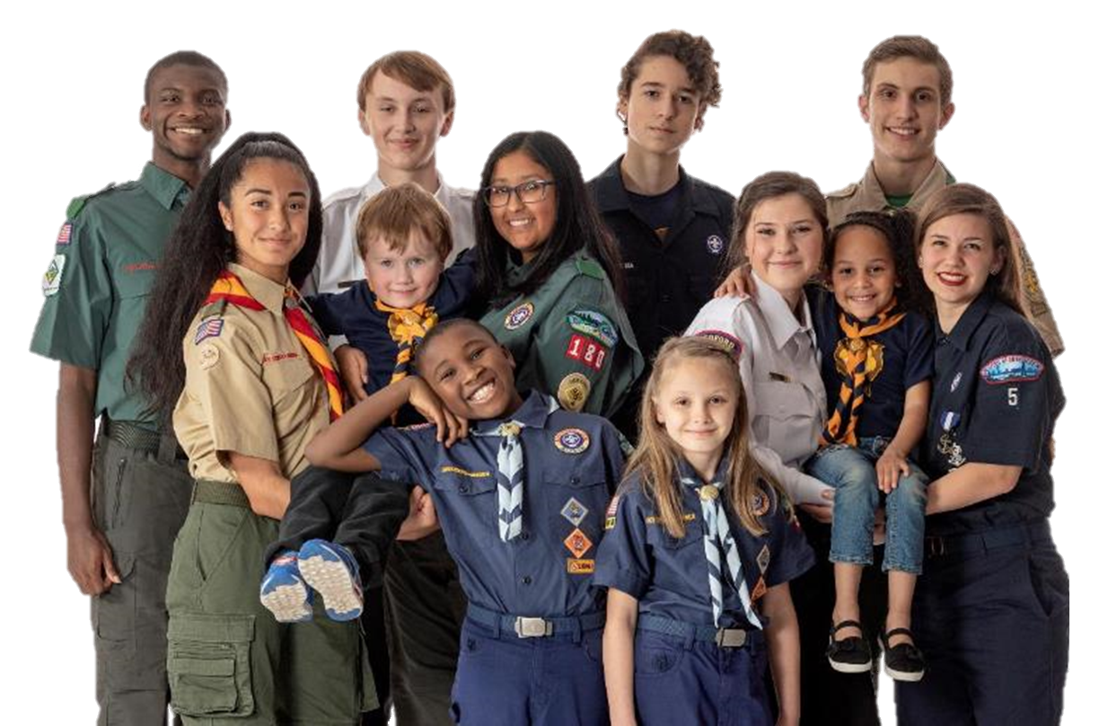
Den Exercise 2

Slide 16
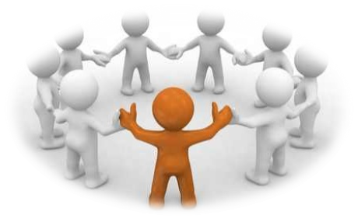
What can we do?

Slide 17
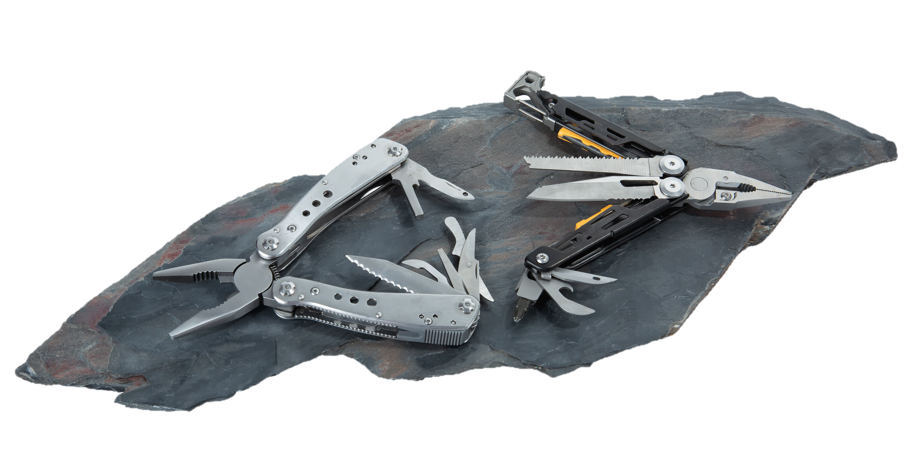
Tool

Slide 18
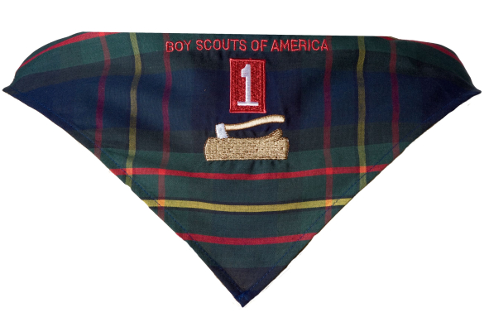
Summary

Slide 19
